Slide 1

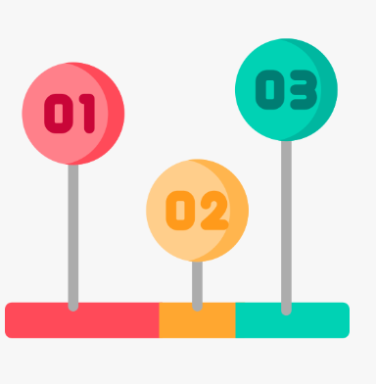



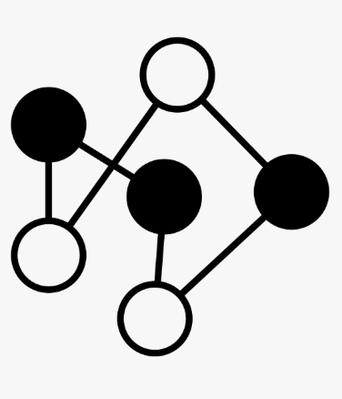

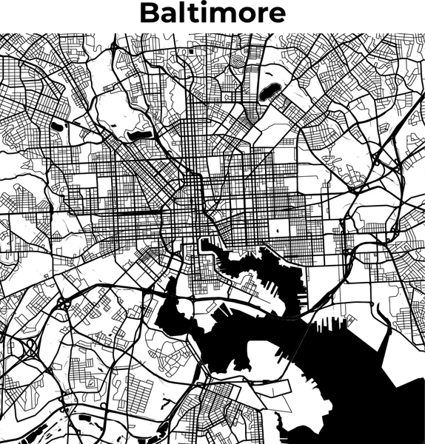









Bus
Nodes
Edges
Daily Traffic

Slide 2

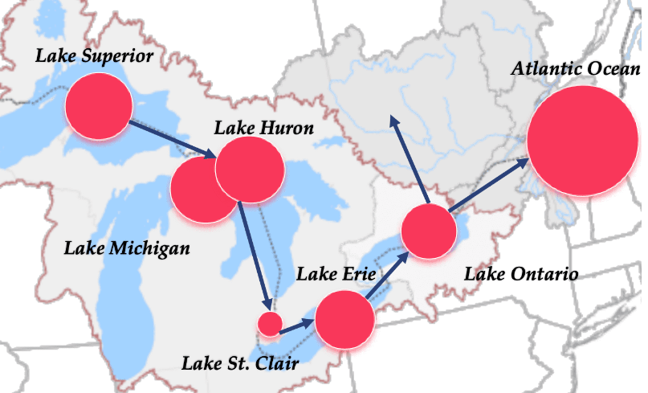
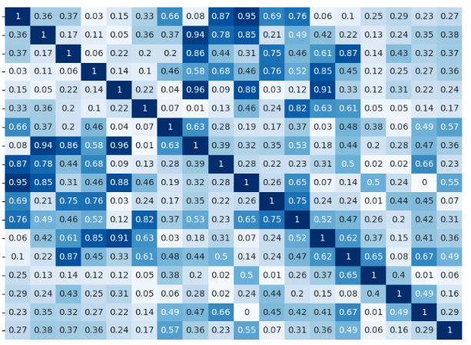
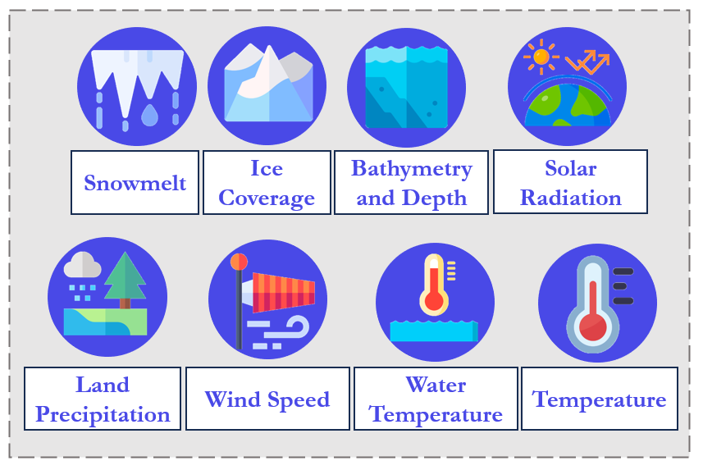
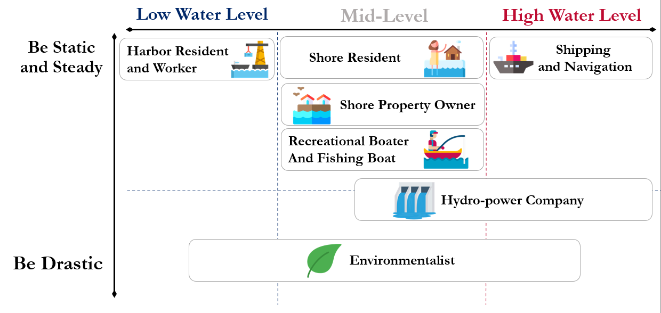

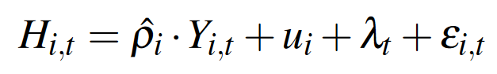
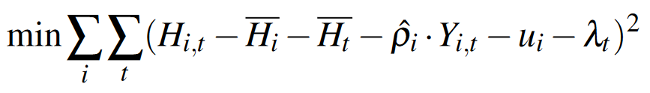
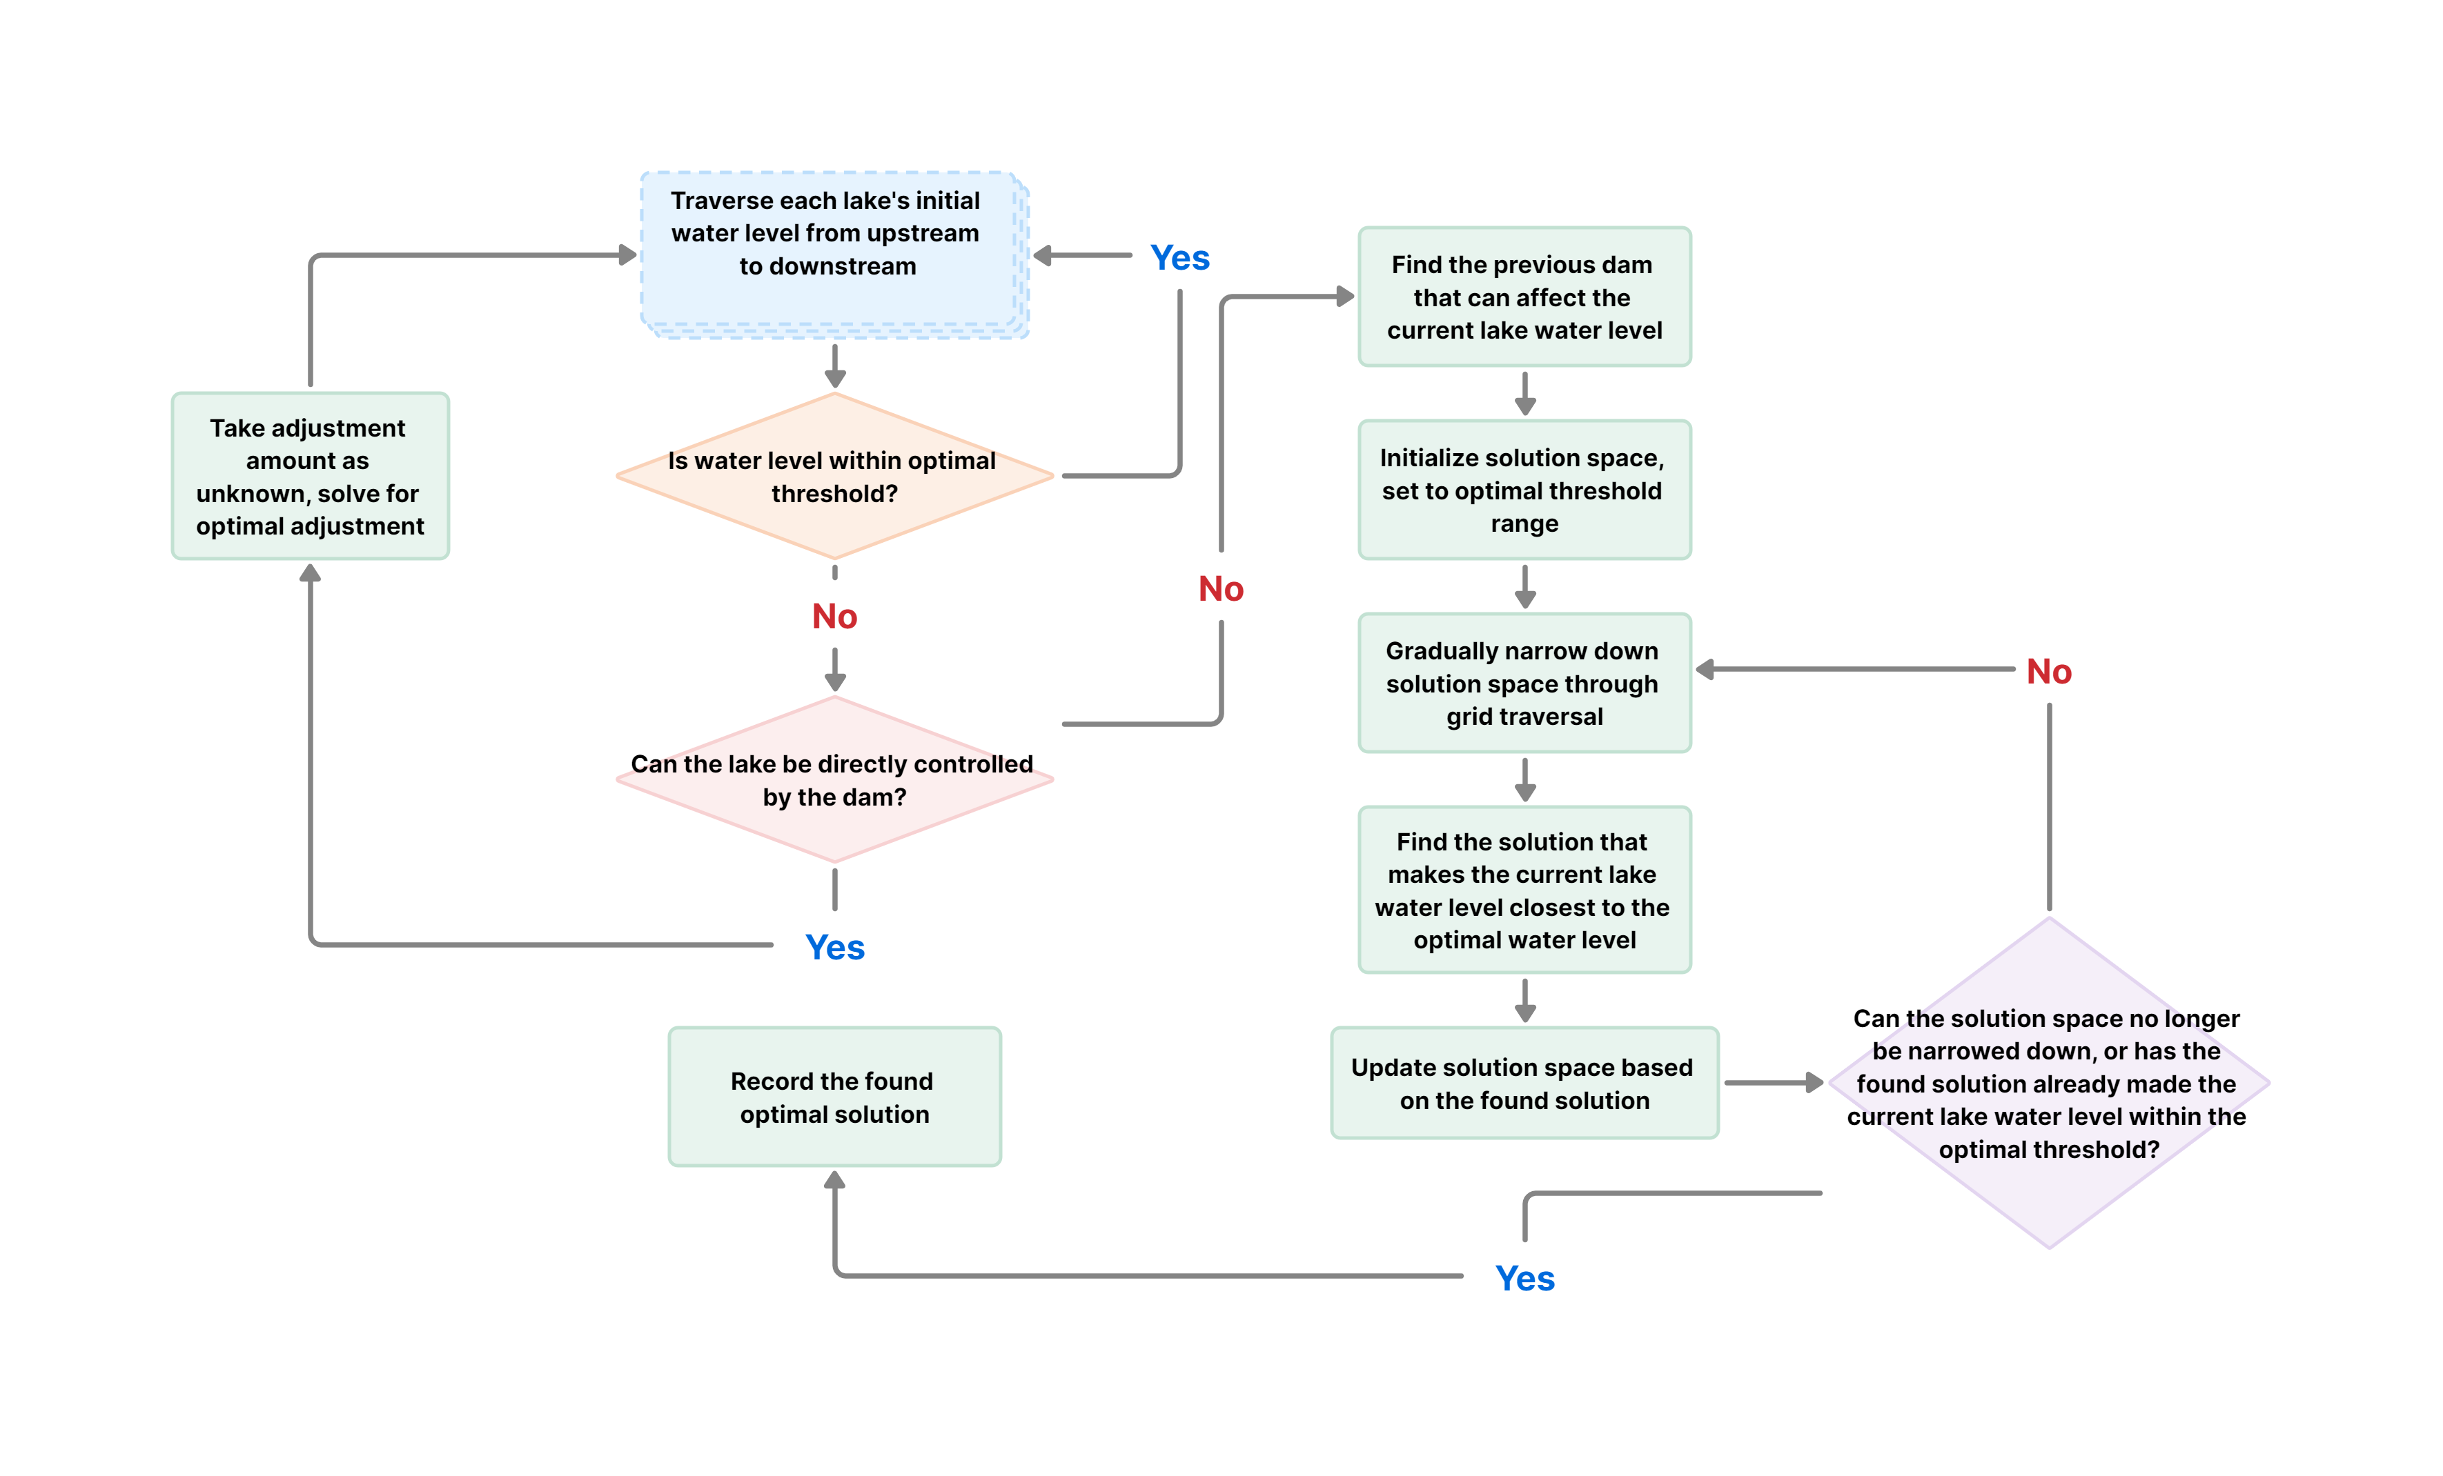
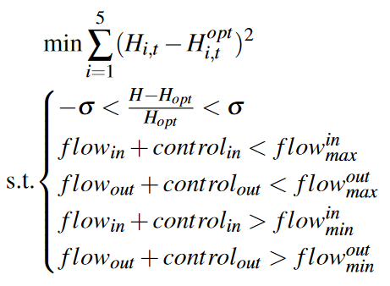
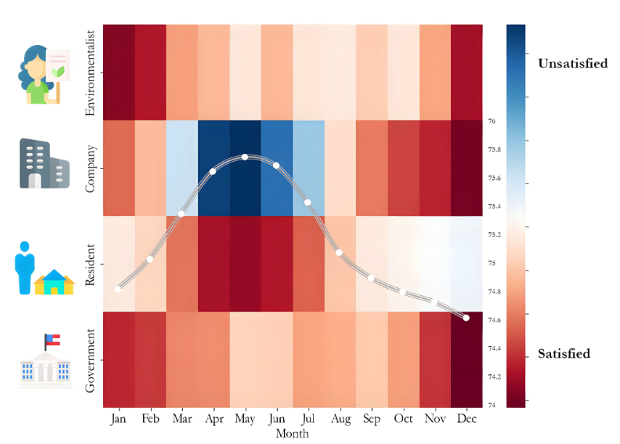
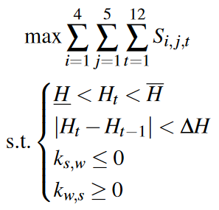
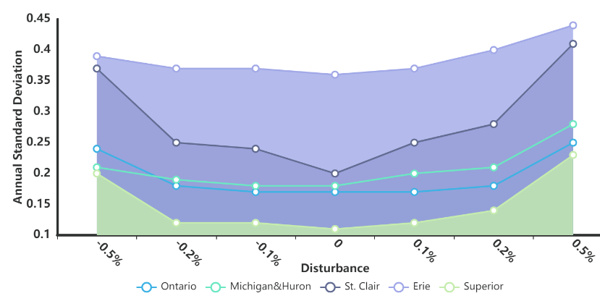
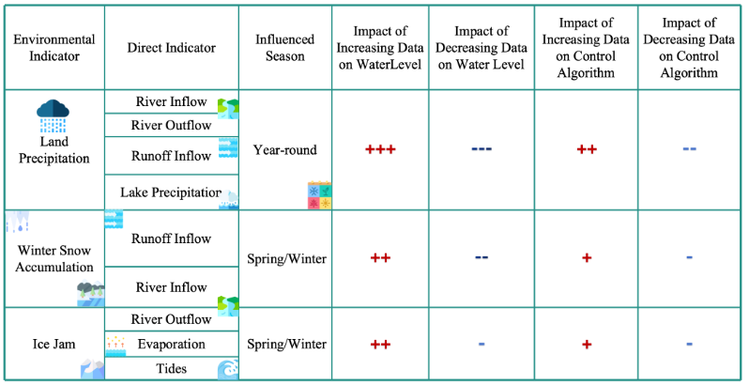
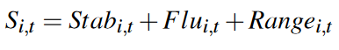
Data Collecting and Preprocessing
Our
Work
Network Initialization
Model Preparation
Select 8 Key Indicators influencing water levels
Data Collecting and Preprocessing
Hydrological Model
A Creative TFE Model solved by LR and LSM
Water Level Variation Model
Categorize Stakeholders into 4 groups
Use AHP to
weight each factors
Perform Goal Programming
Greedy Algorithm
and Grid Traversal
Using Threshold Control
Optimal Water Level Maintenance Model
Evaluate Satisfaction
Strengths:
· Creativity
· Scalability
· Robustness
Perturb the Outflow by 0.1%, 0.2%, and 0.5%
Perturb environmental impact factors
Optimal Water Level Model
Sensitivity Analysis

Slide 3

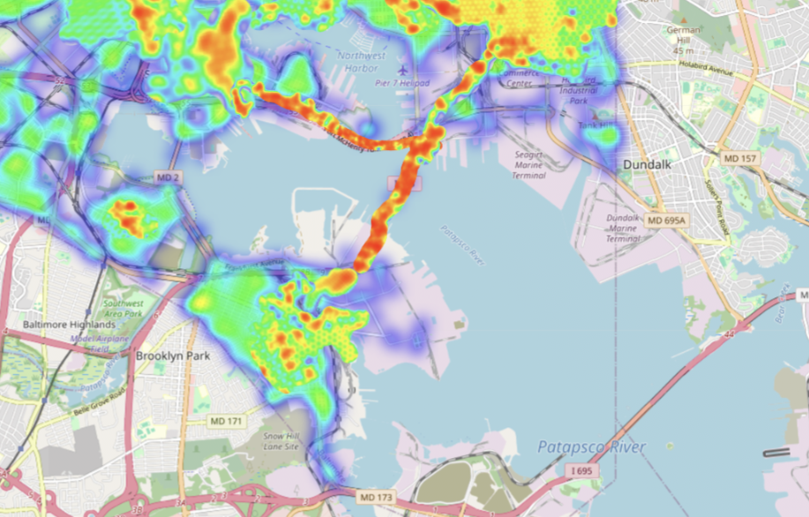
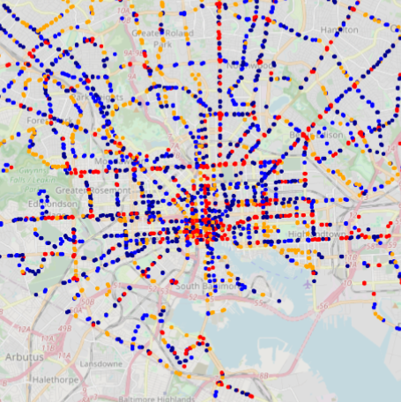
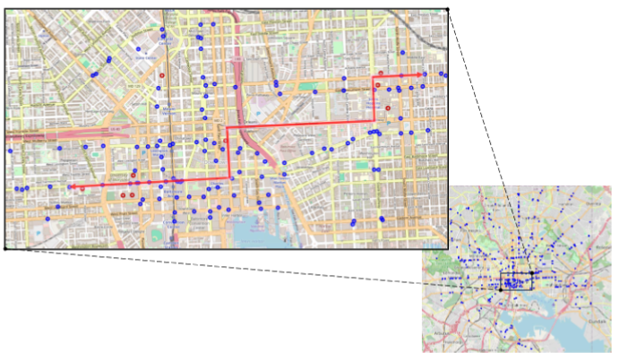
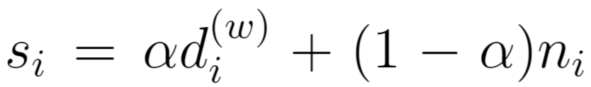
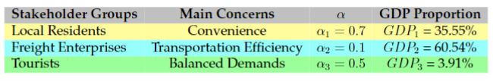
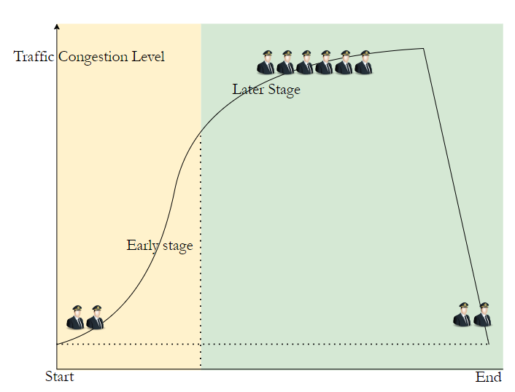
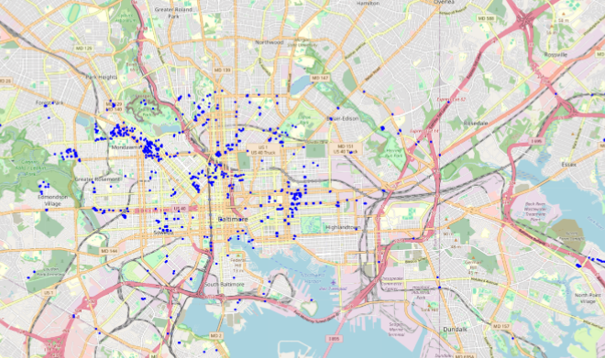
After Bridge Collapse
Our
Work
Data Collecting and Preprocessing
Network Initialization
Model Preparation
Problem 1: Network Importance Increase
Improved K-Shell Algorithm
Node Weights and Edge Weights based on
Baltimore Transport Network
Bus Route Optimization Plan
BPR Function
AADT Fast Filling, etc.
Problem 2: Application of the Network
Congestion Management
Visualization of the Baltimore Transportation Network
Sensitivity Analysis
Problem 3: Best Improvement of the Network

